Slide 1
Foldable Phones
An Analysis of the Foldable Phone Sector
Apoorv Awasthi

Slide 2
Table of Contents
ID | Section | Slide #
1 | Research Objective | 3
2 | Research Specifications | 5
3 | Market Growth & Potential | 7
4 | Existing Players | 13
5 | Consumer Interest & Demand | 15
6 | Key Takeaways | 19

Slide 3
Section 1
Research Objective

Slide 4
Research Objective
This research is being carried out to determine:
What is the size and growth potential of the foldable phone market?
How many phone markers are building foldable phones?
Does this product category have staying power, or is it a fad?
What does consumer interest and demand for foldable phones look like?

Slide 5
Section 2
Research Specifications

Slide 6
Research Specifications
Methodology | Secondary, desktop research
Sample size | N/A
Target audience | N/A
Date of data collection | Research carried out in January 2025
Data sources | IDC Future Market Insights Mordor Intelligence Allied Market Research Counterpoint Research Google Trends

Slide 7
Section 3.1
Market Growth & Potential
Notes:
Sources:
https://www.idc.com/getdoc.jsp?containerId=prUS50531423
https://www.futuremarketinsights.com/reports/foldable-phone-market
https://www.mordorintelligence.com/industry-reports/foldable-smartphone-market
https://www.alliedmarketresearch.com/foldable-smartphone-market-A31849

Slide 8

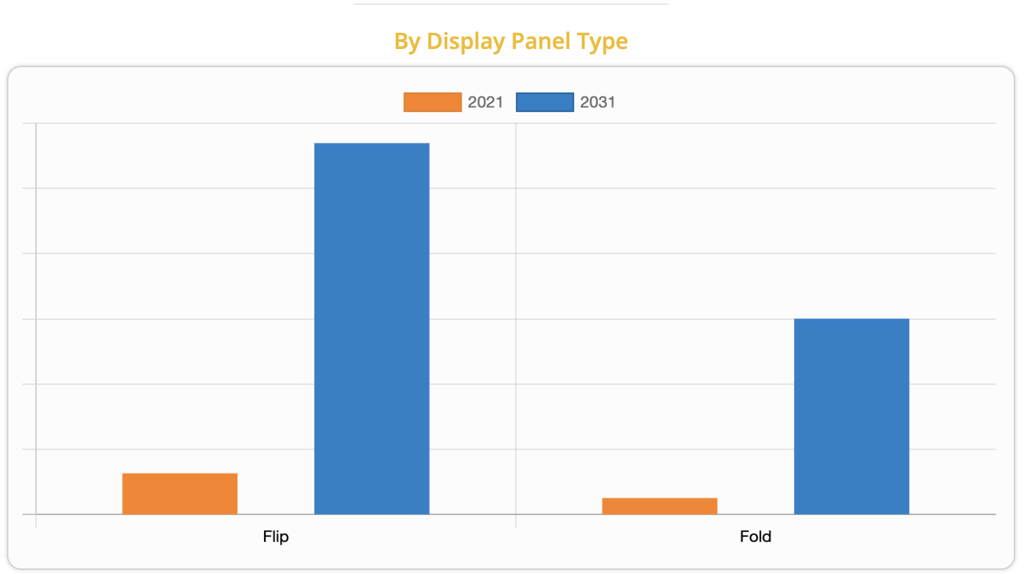
Market Growth & Potential
“The global foldable smartphone market was valued at $17.6 billion in 2021, and is projected to reach $174 billion by 2031, growing at a CAGR of 26% from 2022 to 2031.”
Current market size is significant at 17.6 billion, with plenty of growth expected over the next 10 years
Notes:
Source
https://www.alliedmarketresearch.com/foldable-smartphone-market-A31849

Slide 9

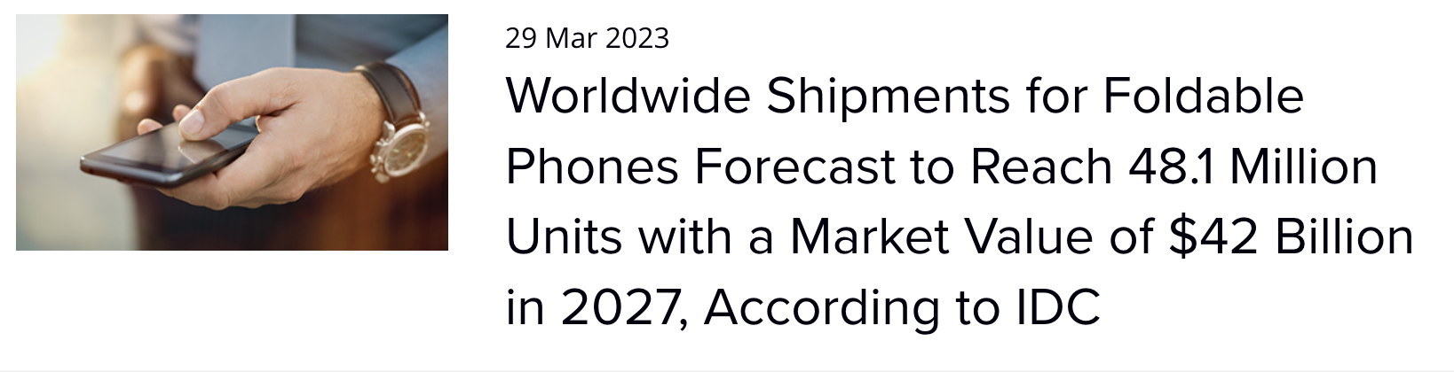
Market Growth & Potential
“International Data Corporation (IDC) expects worldwide shipments of foldable phones, including flip and fold form factors, to reach 21.4 million units in 2023. This represents an increase of more than 50% over the 14.2 million units shipped in 2022”
The IDC predicts healthy turnover in terms of device shipments in 2023, with explosive year-on-year growth over 2022
Notes:
Source
https://www.idc.com/getdoc.jsp?containerId=prUS50531423

Slide 10

Market Growth & Potential
“FMI has forecast the foldable phone market to rise at 25.2% CAGR between 2021 and 2031, in comparison to the 10.2% CAGR registered during 2016 - 2020”
“Sales of foldable phones are largely being driven by the millennial population, where individuals are willing to increase their spending to improve their workspace and living standards.”
FMI predicts strong long term growth over the next decade, and a significant increase in the growth of foldable phone shipments since 2016
Notes:
Source
https://www.futuremarketinsights.com/reports/foldable-phone-market

Slide 11

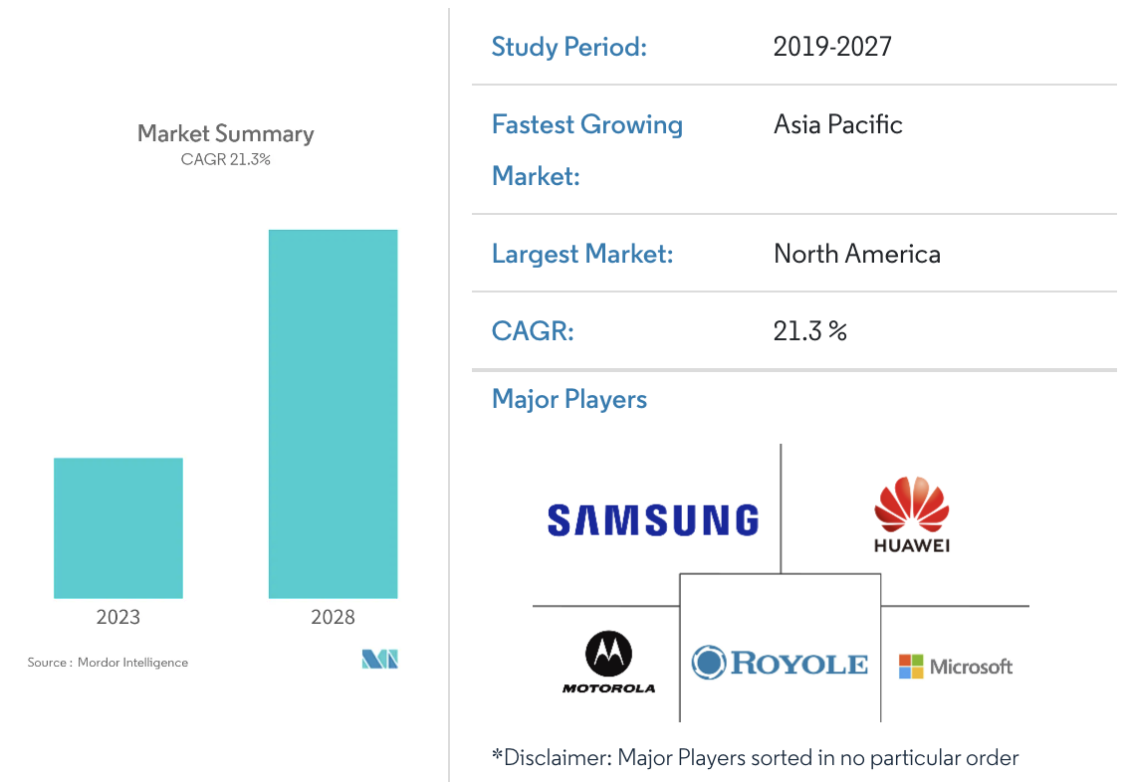
Market Growth & Potential
“The industry is predicted to experience considerable growth throughout the forecast period because of the quickly rising demand for innovative consumer electronics and the increased adoption of smartphones in the entertainment and gaming sector.”
High growth is expected as a result of increased consumer demand for innovative electronics
Notes:
Source
https://www.mordorintelligence.com/industry-reports/foldable-smartphone-market

Slide 12
Market Growth & Potential
“Moreover, with an increase in competition, major market players have started acquiring with companies to expand their market penetration and reach. For instance, in September 2022 Apple inc acquired Necessary Patent much needed patent for a display material containing self-healing properties, which the company plans to use for all the foldable smartphones it plans to manufacture in the future.”
With players like Apple expected to enter the market soon, all signs point to the strong potential and staying power of this innovative product category
Notes:
Source
https://www.alliedmarketresearch.com/foldable-smartphone-market-A31849

Slide 13
Section 3.2
Existing Players

Slide 14
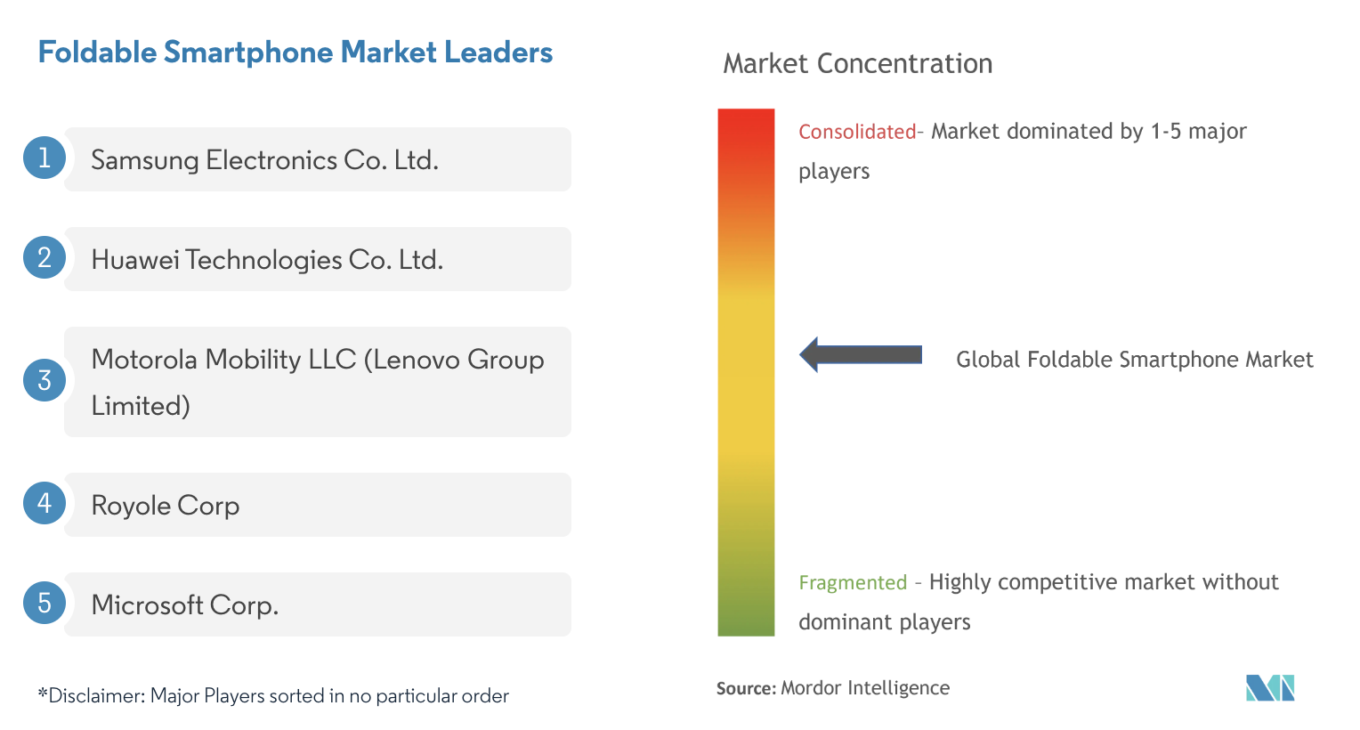
Existing Players
“The foldable smartphone market is moderately consolidated and consists of a few significant players. Some of the players currently dominate the market in terms of market share. However, with the advancement in display technologies, new players are expected to increase their market presence, thereby expanding their business footprint across emerging economies.”
Competition has some ways to go, but new players are expected to enter this product category
Notes:
Source
https://www.mordorintelligence.com/industry-reports/foldable-smartphone-market

Slide 15
Section 3.3
Consumer Interest & Demand

Slide 16
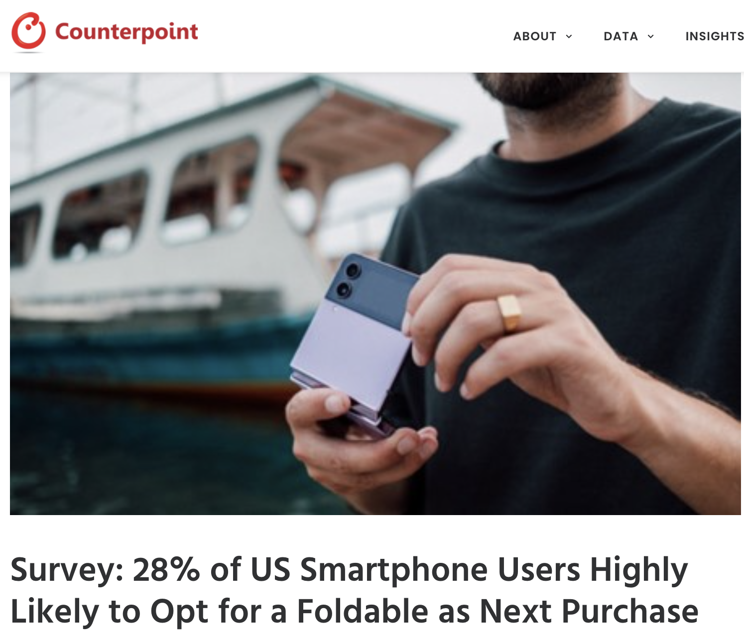
Consumer Interest & Demand
“Samsung remains the first choice for foldable smartphones in the US. However, there is a lot of excitement among consumers for a foldable iPhone, which is evident in the survey.”
A recent study showed that as much as 1 in 3 US consumers are likely to purchase a foldable phone the next time they make a purchase.
Notes:
Source
https://www.counterpointresearch.com/survey-28-of-us-smartphone-users-highly-likely-to-opt-for-a-foldable-as-next-purchase/

Slide 17
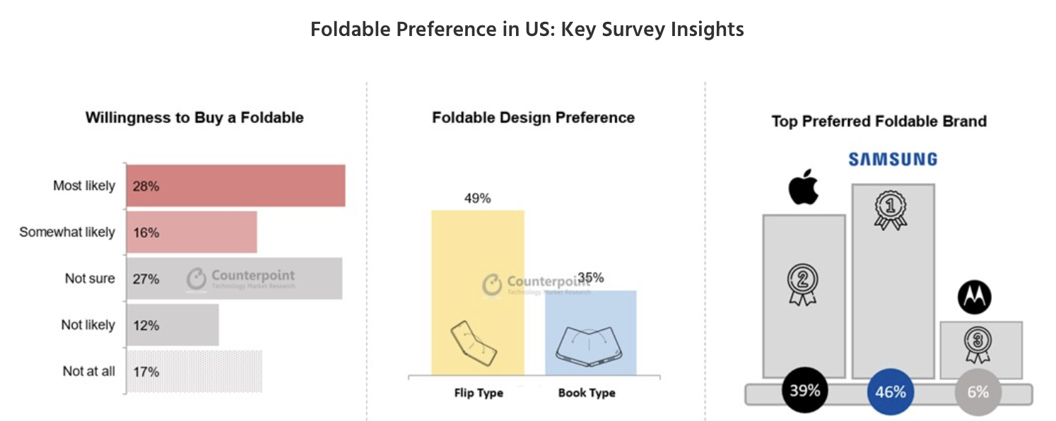
Consumer Interest
Despite the fact that Apple has yet to make a foldable, interest in Apple foldable phones is high, suggesting that when Apple do enter the category market share may rise even more
Notes:
Source
https://www.counterpointresearch.com/survey-28-of-us-smartphone-users-highly-likely-to-opt-for-a-foldable-as-next-purchase/

Slide 18
Section 4
Key Takeaways

Slide 19
Key Takeaways
Question
Insight
What is the size and growth potential of the foldable phone market?
Valued at $17.6 billion in 2021, projected to reach $174 billion by 2031.
How many phone markers are building foldable phones?
Samsung dominates, with 5 main players capturing most of the market. But more entrants expected.
Does this product category have staying power, or is it a fad?
With companies like Apple filing patents for foldable phones, and 25% CAGR expected between now and 2031, the foldable phone market appears to have a bright future
What does consumer interest and demand for foldable phones look like?
1 in 3 US consumers very likely to buy foldable phones when they make their next purchase

Slide 20
Thank You

